Slide 1
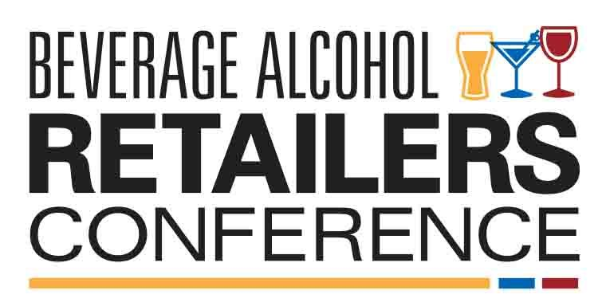
Benefits of Training

Slide 2
Who we are at a glance
Established in 1969 to meet the training needs of the UK wine industry, WSET has since grown to become the global standard in wine, spirits and sake product education.
Our mission is to provide accessible, best-in-class education and qualifications to inspire and empower the world’s wine and spirit professionals and enthusiasts.
As an independent, not-for-profit organisation our products offer impartial and sound learning on which individuals and businesses can build knowledge and expertise.
We work closely with the drinks industry, educational partners and regulatory authorities to ensure all our products are
job-relevant and fit-for-purpose.

Slide 3




WSET in the USA
WSET courses were first offered in the USA in 1994. Today the USA accounts for the third largest number of WSET candidates, after the UK and China, with candidates hailing from all sectors of the wine and spirits trade.
Our customers
Some of the most recognized names in the drinks and hospitality industries use our courses to train and develop their people, including:
“I like to speak about how WSET programs provide our employees with the 3 Cs:
1) Confidence – to do their job more effectively,
2) Credibility – to speak with authority about our brands
3) Culture – to enhance their passion and enjoyment of wine & spirits.”
- Peter Marks MW, Constellation Brands USA

Slide 4
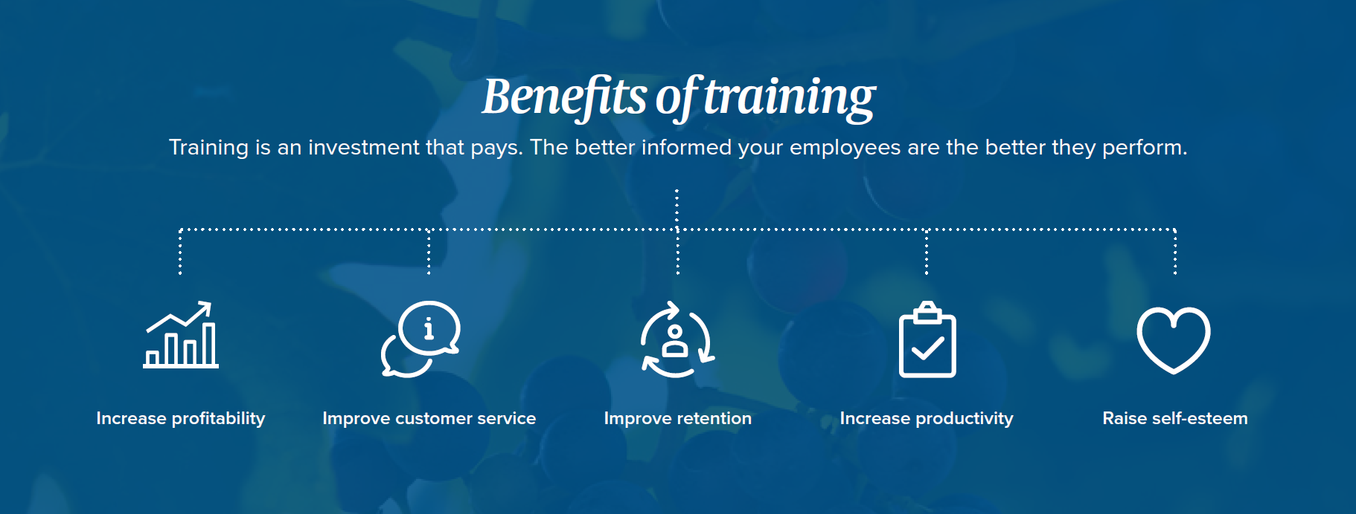

Slide 5


Benefits of WSET training
Develop tasting technique using the WSET Systematic Approach to Tasting
Clear & transparent course and assessment structure
Globally trusted & recognized
Job
relevant
Brand neutral
International focus & syllabus

Slide 6



Level 1 Qualifications
Entry-level courses for those new to the subject matter.
These courses provide hands-on learning, ideal for individuals who are new to working in the drinks or hospitality industries or enthusiasts.
WSET Level 1 Award in Wines
Explore the main types and styles of wine through sight, smell, and taste, while also gaining the basic skills to describe wines accurately, and make food and wine pairings.
WSET Level 1 Award in Spirits
Discover the main styles and types of spirits through sight, smell, and taste to develop an understanding of the key factors affecting flavours and aromas, and how cocktail recipes work.
Delivery
Level 1 courses are available as classroom-based learning. These qualifications have a minimum requirement of six guided learning hours with a WSET course provider and are typically offered in a one-day study format.
Assessment
Assessment is by a closed-book exam of 30 multiple-choice questions.
WSET Level 1 Award in Sake
Explore the main styles and types of sake through sight, smell and taste to develop an understanding of the key factors affecting flavours and aromas.

Slide 7


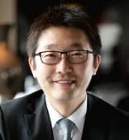
Level 2 Qualifications
Courses suitable for those who have basic knowledge of the subject matter.
These courses provide comprehensive training to develop a student’s knowledge to intermediate level.
WSET Level 2 Award in Wines
Explore the major grape varieties and important wine regions in which they are grown. Learn about the styles of wines produced from these grapes as well as key classifications and labelling terminology. A basic overview of the key categories of spirits will also be provided.
WSET Level 2 Award in Spirits
Learn about the fundamental production methods and principal raw materials and discover how they are used to make the key spirit styles. An exploration of the key practices and principles of serving spirits and the use of spirits in cocktails is also included in this course.
Delivery
Level 2 Awards are available as classroom-based or online learning. The Level 2 Award in Wines and Spirits has a minimum requirement of 28 hours of study time, including 16 hours of classroom or online delivery time. The Level 2 Award in Spirits has a minimum requirement of 26 hours of study time, including 14 hours of classroom or online delivery time.
“WSET education has been extremely valuable for my career and is an important qualification for anyone who wishes to get into the wine or hospitality industries.”
Assessment
Assessment is by a closed-book exam of 50 multiple-choice questions.
Yang Lu DipWSET, Corporate Wine Director, Shangri-La International Hotel Management Ltd.

Slide 8



Level 3 Qualifications
Level 3 qualifications are advanced-level courses for individuals seeking in-depth knowledge of the subject matter.
Delivery
The Level 3 Award in Wines is available as classroom-based or online learning. It has a minimum requirement of 84 hours of study time, including 30 hours of classroom or online delivery time.
WSET Level 3 Award in Wines
Gain a detailed understanding of grape growing and wine making. Upon completion you will be able to assess wines accurately, and use your understanding to confidently explain wine style and quality.
WSET Level 3 Award in Sake
Develop a detailed understanding of the production methods that affect the style, quality and price of sake. Upon completion you will be able to assess sakes accurately, and use your understanding to confidently explain style and quality.
The Level 3 Award in Sake has a minimum requirement of 42 ¼ hours of study time, including 16 hours of classroom delivery time. There is also a recommended online module, “Introduction to Sake” that should be completed in advance of the course.
“It was such a brilliant experience! From my point of view it was great to taste so many products in an unbiased and marketing-free environment.”
Kristiane Sherry, Editor, Master of Malt
Assessment
Assessment is by 50 multiple-choice questions, a paper of short written answers, and a blind tasting of two samples.

Slide 9
Contact Us
If you have any questions or queries or would like to discuss next steps please contact:
Rob McCaughey
USA Business Development Manager – Spirits
E: rmccaughey@wsetglobal.com
C: 609 433 7912
W: wsetglobal.com

