Slide 1
Change & Customers for Life
Sam Dantzler, Garage Composites
President

Slide 2
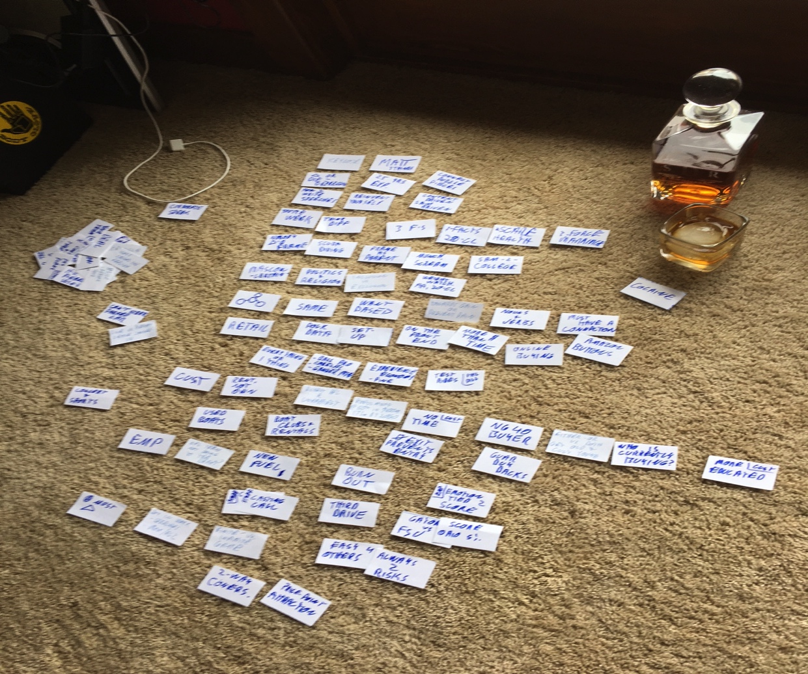

Slide 3
What is Garage Composites?

Slide 4
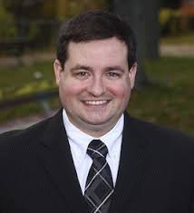
Jeremy Nedelka

Slide 5
Speech Prep
Connecting Puzzle Pieces

Slide 6
Change
Consumers
Employees
Retailing

Slide 7
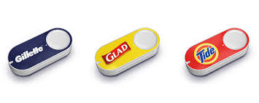
Retail Today
Online Buying
“Buy it Now”
Amazon Buttons

Slide 8
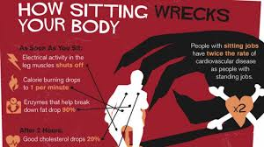
This conference…
Many are telling you to do “it” differently. How?
Data?
Scaring You?
Force?
Guilt?

Slide 9
Change Your FRAME!

Slide 11
But How Is It the Same?
Revolves around Human Connection
Nouns Need Verbs
MUST Have the
Connection!

Slide 14
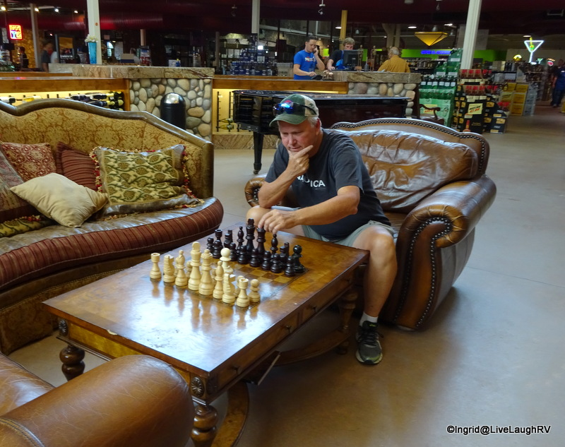
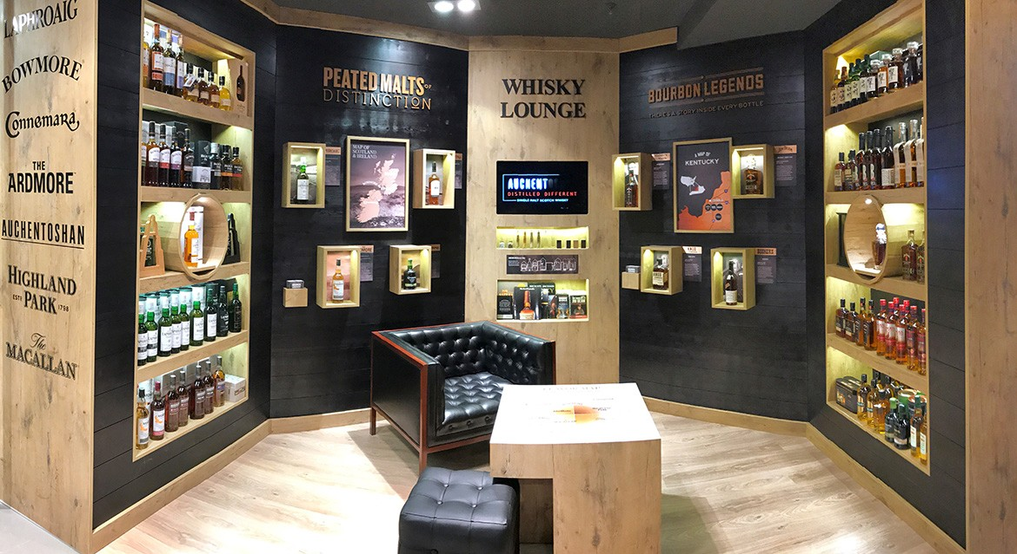

Slide 15
Change Your FRAME!

Slide 16
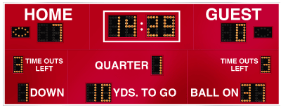
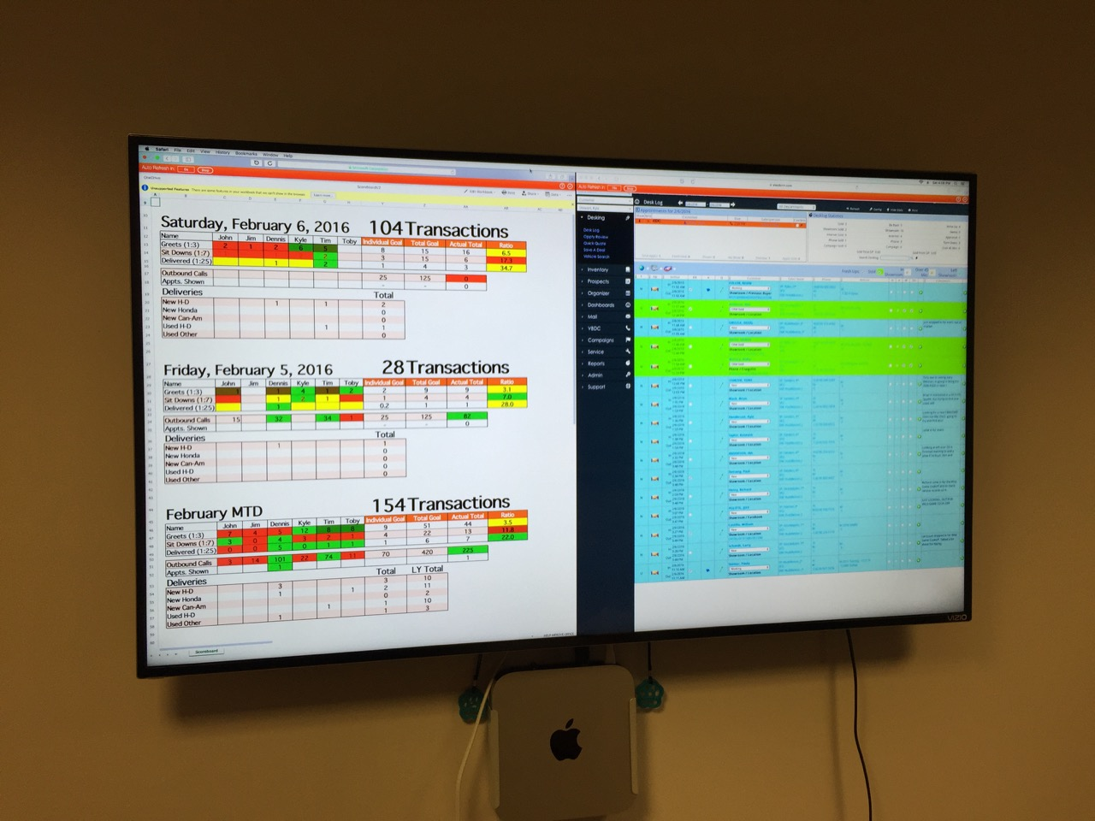
Employee Re-Frame
Keep Score = Emotion!

Slide 17
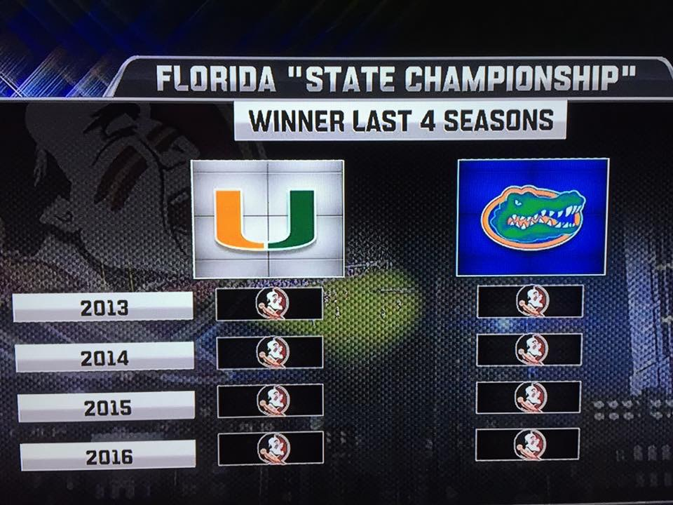

Slide 18
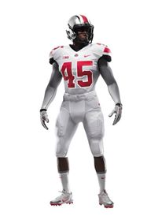

Slide 19
Change
Consumers
Employees
Retailing

Slide 20
Biggest Change Impediment?

Slide 22
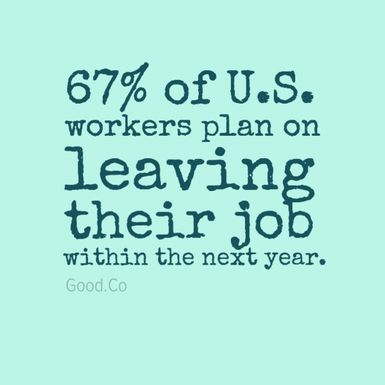
Customer State of Mind

Slide 23
“Sales = Transfer of Enthusiasm” - ZZ

Slide 24
How many cases of _______ did you sell last year?

Slide 25
What if everyone who bought something from you only ever came back to buy from you?

Slide 26
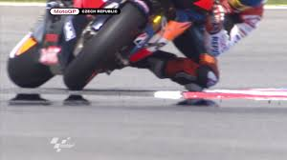
People First, then Product
Counter-Steering!

Slide 27
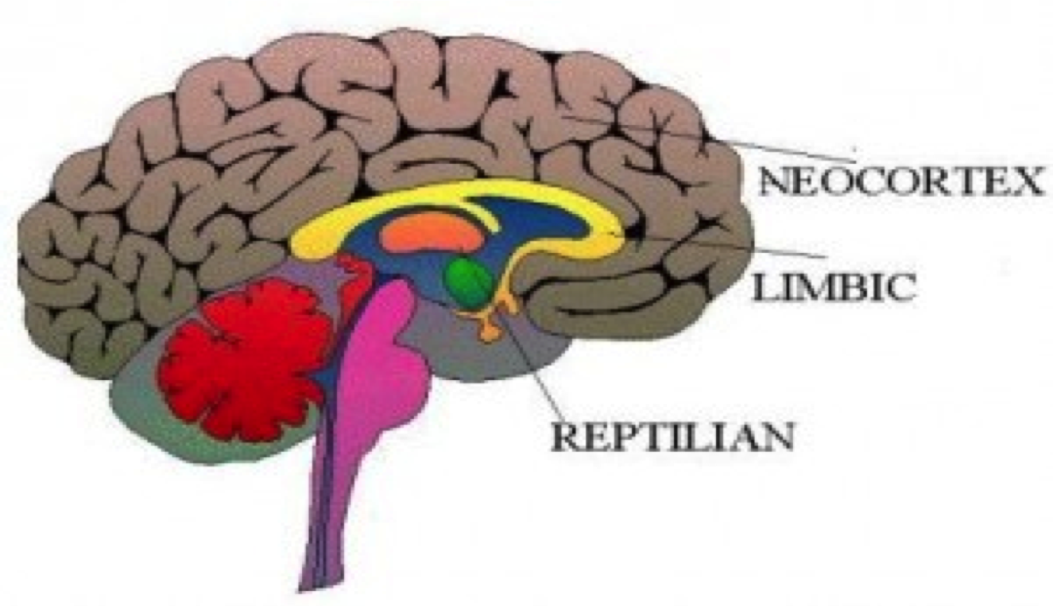
The Human brain

Slide 28
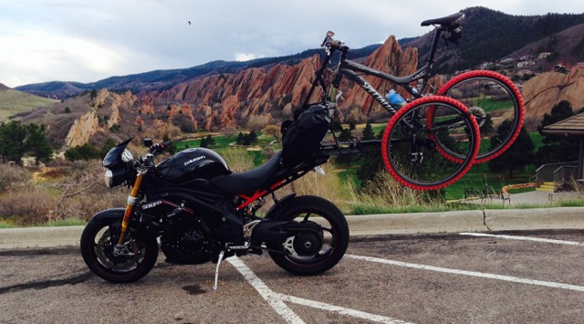
Emotion over Logic…

Slide 30
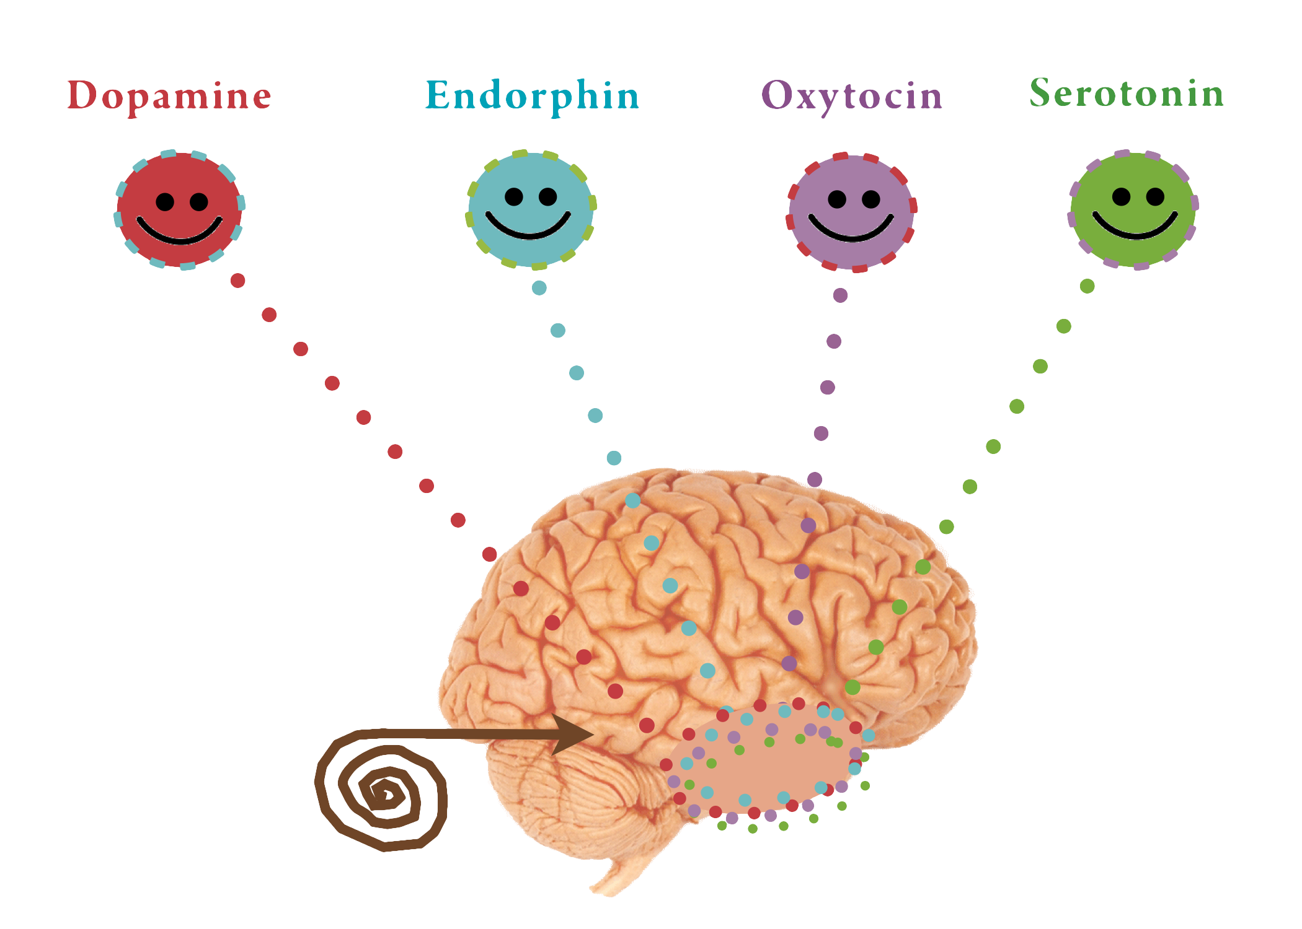

Slide 31
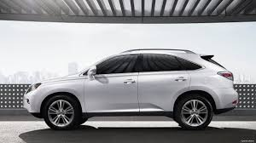
The Lexus Experience
LEFT SIDE = PRODUCT | RIGHT SIDE = PERSON
RX350 | Brandi Dantzler
Oil Change | Sam
50K mile service | Abigail, Swim Lessons
ES 300 | Leather Chair
Jim Foster | Cappuccino

Slide 32
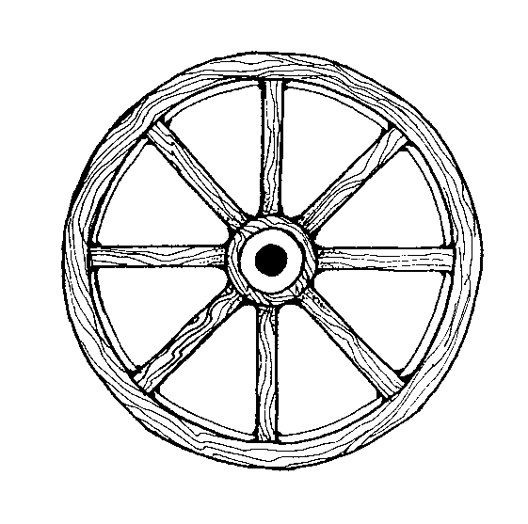
FORMAT!
F = Family
O = Occupation
R = Recreation
M = Motivation
A = Animals
T = Teams

Slide 33
Emotion = Margin!
What do people love talking about?
How many of you have ever KNOWINGLY paid more for something because of WHERE you bought it from or WHO you bought it from?
Margin = state of mind
Disney vs. Universal Studios
Dive bar vs. Martini bar

Slide 34
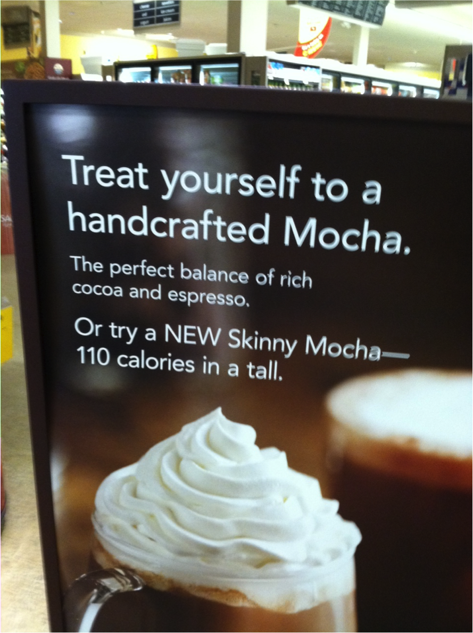
You Get What You Give!
Retention
Loyalty is 100% tied to having an emotional experience
Franklin Covey

Slide 36
Formula to Loyalty without discounts =
People, then Product
Get Emotional
FORMAT
Thanks & Invite Back

Slide 37
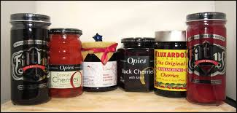
Hardest Part of the Job…
Repetition
It’s easy at 9am
5 minutes to close?

Slide 38
How to find me!
Sam Dantzler
sam@garagecomposites.com
www.samdantzler.com

