Slide 1
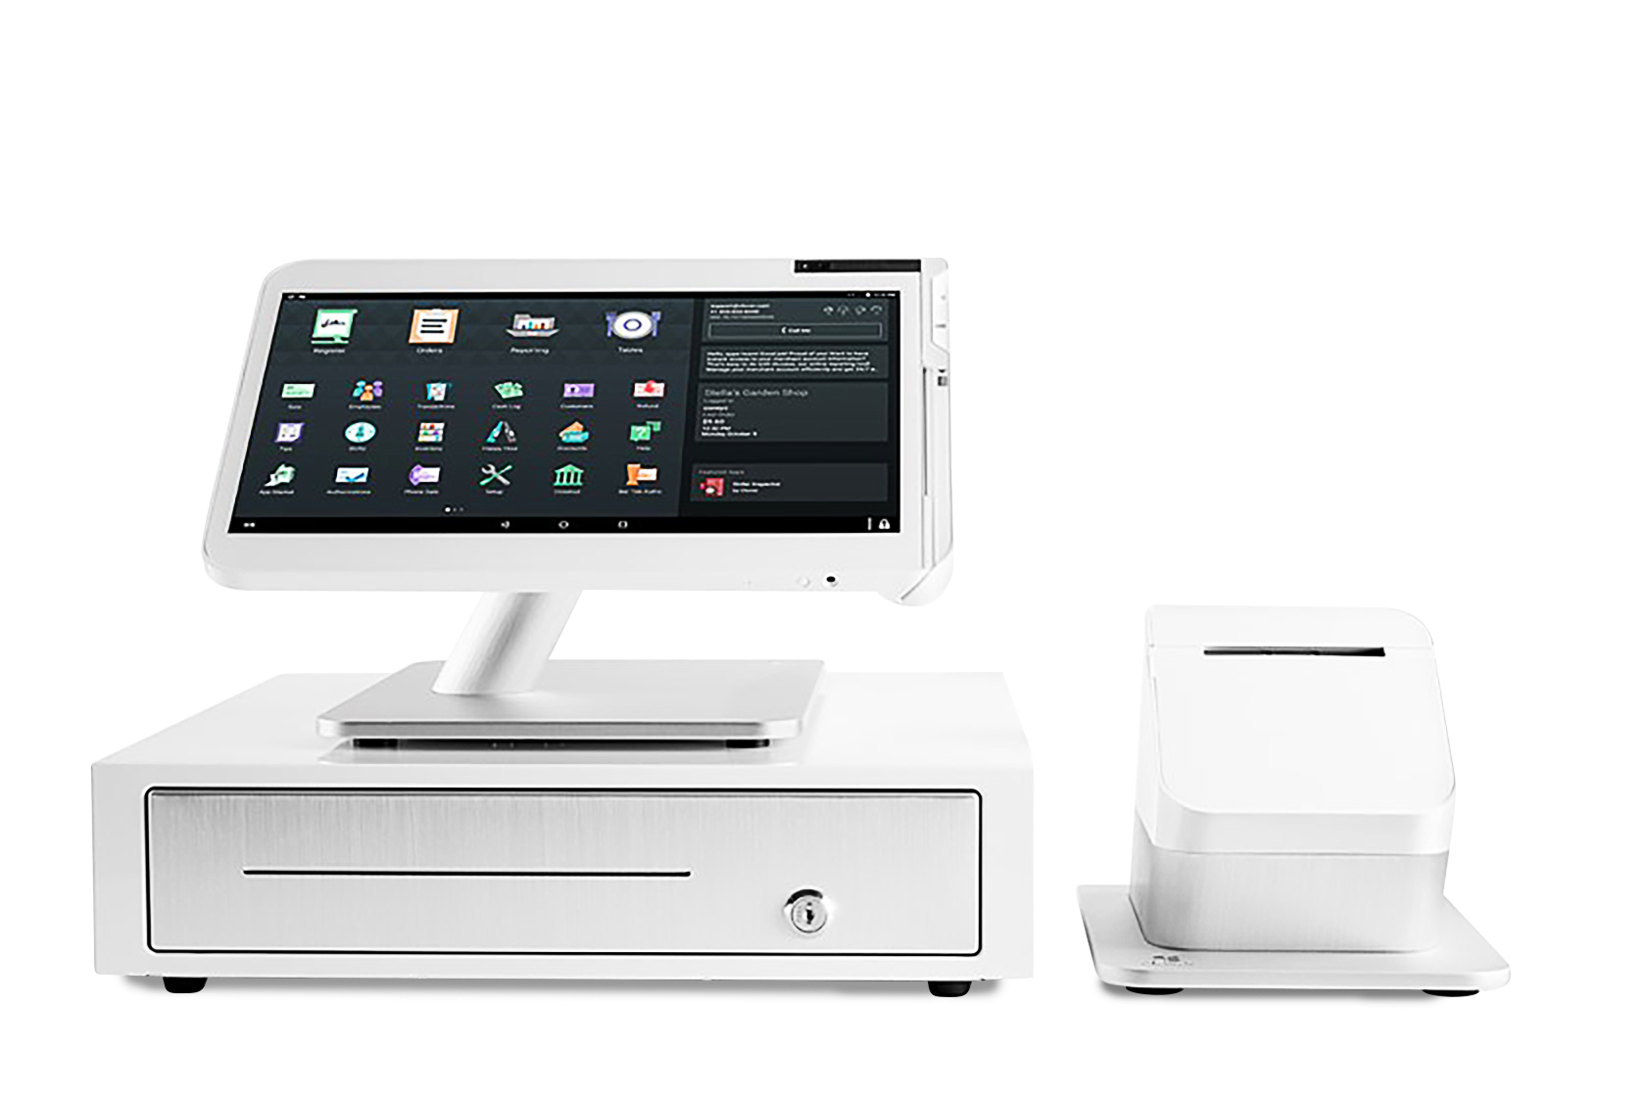
Clover @ BARC

Slide 2
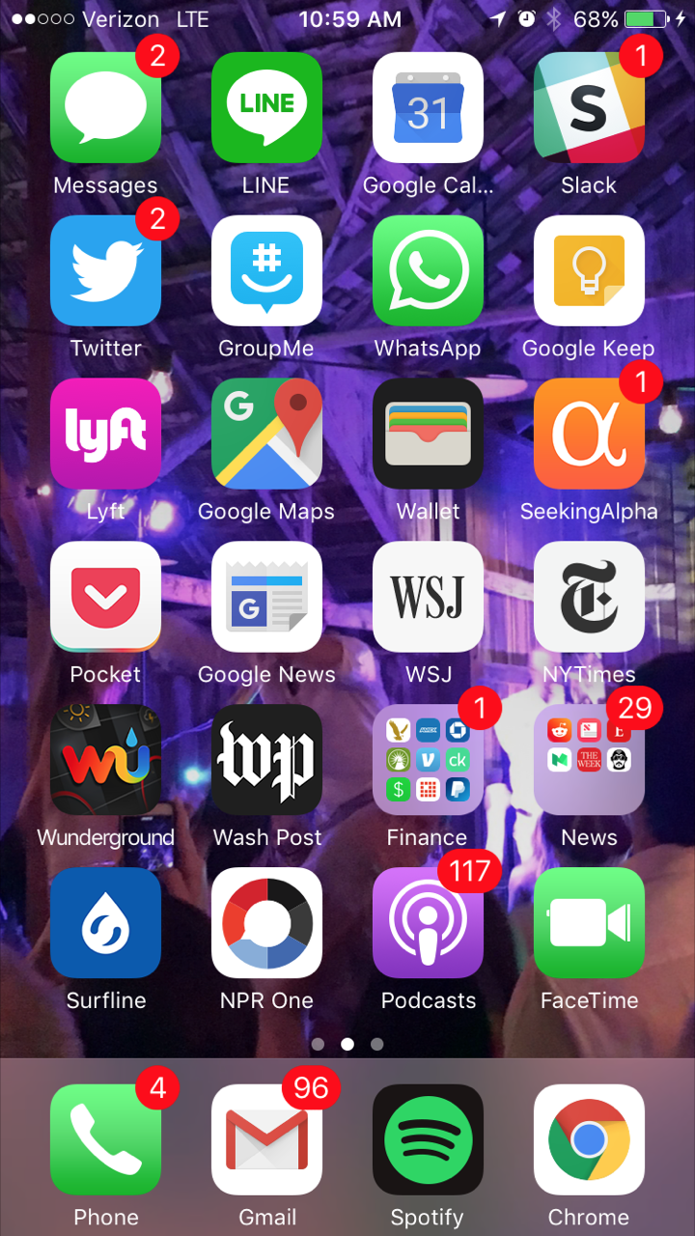
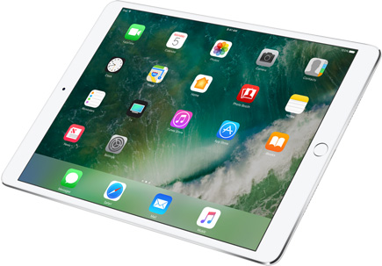
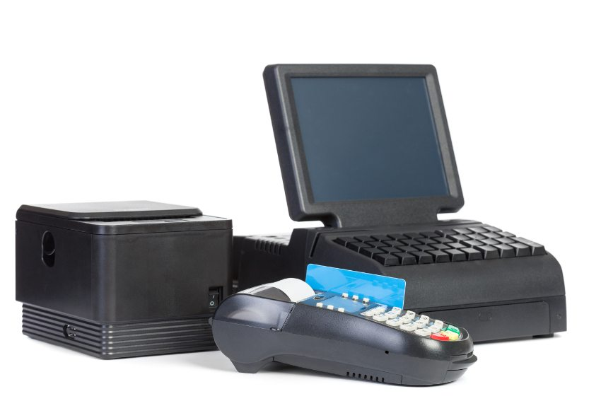
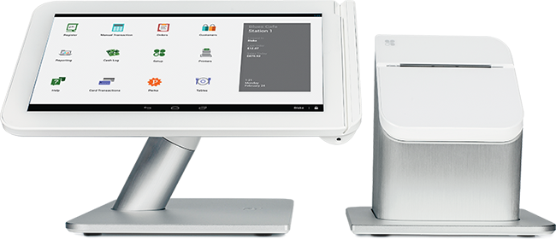
Device & App (R)Evolution
Notes:
We all have seen and witnessed an evolution, where developers have changed the way we interact in the world. The creation of apps and app markets have changed everything. Apps, they help us manage our money, our time, our life. They are not just apps to us. They are solutions for our lives.

Slide 3
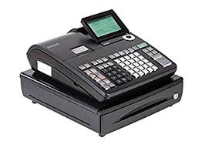
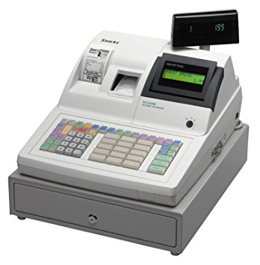
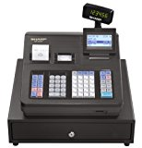
The Past: Cash Registers
Casio ECR
Sam4s ECR
Sharp ECR
With an Electronic Cash Register...
You can: Take cash payments Have limited inventory Have limited employee permissions Use non-intuitive item names (PLU numbers) Have 1-day’s worth of payments reporting Have 1-day’s worth of employee reporting | You can’t: Get employees up and running without training Efficiently manage a growing business Retrieve data for more than 1 day Take cards (requires separate reader) Save orders to pay later Manage employees Etc.

Slide 4
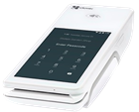
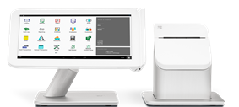
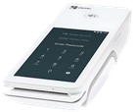
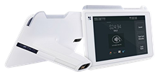
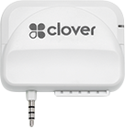
The Future: Cloud POS
Countertop
Clover Flex
Clover Mini
Clover Station
Hand-over countertop experience with electronic signature capture
Next generation countertop terminal, ECR replacement or point-of-sale
Connects to cash drawer
QSR, FSR-lite and Simple Retailers looking for a robust business management system
Mobile
Clover Go
Clover Flex
Clover Mobile
“Bring Your Own Device” (BYOD), micro merchants, multi-MID or mobility only SMBs
Small, mobile-optimized device with a built in printer, 1D/2D barcode scanner, camera and long battery life
Larger screen. Takes you off the counter and onto the floor for personal engagement with customers
Notes:
This slide shows how merchants can integrate other Clover devices into their business as it evolves – and Station works seamlessly with them all.

Slide 5
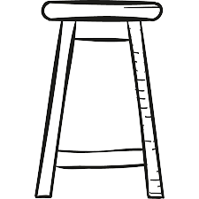
Clover for Bars
Clover Bar Tabs
Pre-auth
Send tabs to Table Parties
Employee Management to Recruit, Hire, Schedule and Pay
Manage Inventory
Local Sales Tax Sync

Slide 6
Clover for Liquor Stores
Manage Inventory
Local tax reconciliation
Check IDs
Employee Management
Sell Online
Bring Online Customers into Your Store

Slide 7
Must-Have Apps for Bars & Liquor Stores
Employee Management
Tax & Accounting
Time Clock
Payroll
Quickbooks & Xero Sync
Sales Tax Automation
Homebase
Gusto
Commerce Sync
DAVO
Free time clock & employee scheduling.
Refreshingly easy payroll for small businesses.
Your automated bookkeeper.
Automate sales tax.
Marketing
Operations
Yelp for Business
Wifi Marketing
Installation Services
Order Paper
Yelp
VivaSpot
Tech-Zone
Abreeze
Claim your Yelp Business Page and attract more customers.
Use WiFi to collect emails, feedback and foot traffic data while boosting social media awareness.
Professional installation services and training for Clover.
Order paper for your Clover device, from your Clover device.

Slide 8
Tools for Bars
Link a Card
Search & Add Drink Recipes
Stock Management
Pre-auth cards for tabs
16,000 drinks you can print, search, edit, or add your own.
Know exactly how much you have in your inventory
+
Clover
BarPro w/ Age Verify
Bottle Keeper

Slide 9
Tools for Liquor Stores
Sell Online
Online to In Store
Check IDs
Sell beer, liquor and wine on the largest online alcohol marketplace
Get your inventory listed on Google maps and bring in customers
Age verification for alcohol purchases
Drizly Alcohol E-commerce
Pointy
Age Verification by Appheaven

Slide 10
Thank you

